Slide 1
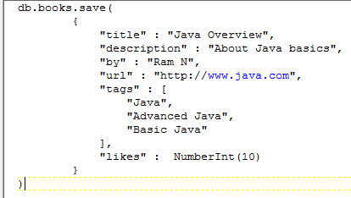
MongoDB - Insert Document (save method)
To insert the document we can use save(document) also. If you don't specify _id in the document then save() method will work same as insert() method. If you specify _id then it will replace whole data of document containing _id as specified in save() method.
Syntax
db.COLLECTION_NAME.save(document)
Example to Insert Single Document
Here books is our collection name. If the collection doesn't exist in the database, then MongoDB will create this collection and then insert a document into it.
In the inserted document, if we don't specify the _id parameter, then MongoDB assigns a unique ObjectId for this document.
db.books.find({}).pretty()

Slide 2
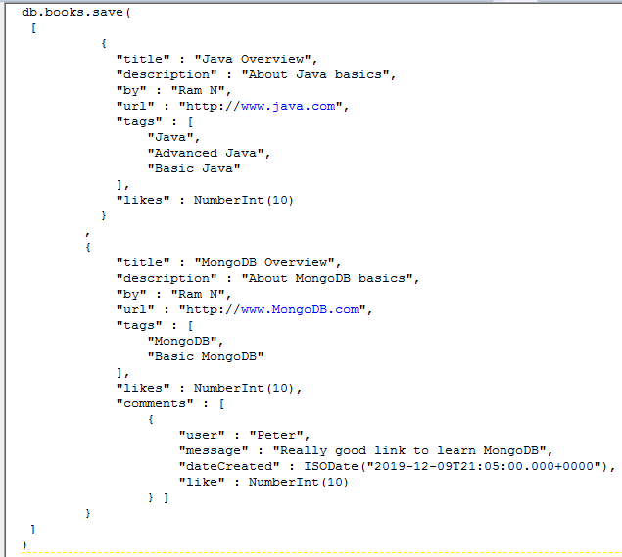
MongoDB - Insert Document (save method)
Example to Insert Multiple Documents
To insert multiple documents in a single query, you can pass an array of documents in insert() command.

